Slide 1
Digital Portfolio
STUDENT NAME: V.DINESH KUMAR
REGISTER NO : 222410032
NMID: 9C2F1FB487F4D139CEE4DBA526F81272
DEPARTMENT: BCS
COLLEGE: APLLO ATS & SCIENCECOLLEGE/ MEDRAS UNIVERSITY

Slide 2
PROJECT TITLE
PERSONAL PORTFOLIO WEBSITE
USING FRONT _END DEVELOPMENT

Slide 3


AGENDA
Problem Statement
Project Overview
End Users
Tools and Technologies
Portfolio design and Layout
Features and Functionality
Results and Screenshots
Conclusion
Github Link
3/21/2024 Annual Review

Slide 4

PROBLEM STATEMENT
Students often struggle to present their skills and projects effectively. Static resumes don't reflect creativity, coding ability, or interactivity. A need for a responsive personal portfolio website to showcase talent in a professional way.

Slide 5

PROJECT OVERVIEW
This project is a Responsive Portfolio Website created using HTML, CSS, and JavaScript. Purpose: Introduce myself (About Me) Highlight skills (Frontend, Backend, DB) Showcase projects with live demos Provide easy contact options

Slide 6

WHO ARE THE END USERS?
Recruiters - to check technical skills & projects Faculty & Classmates - academic presentation General Audience - online visibility & networkin

Slide 7

TOOLS AND TECHNIQUES
Development - HTML (structure), CSS (styling), JavaScript (interactivity). Design - Font Awesome icons, custom images, profile photo. Hosting & Control - GitHub, GitHub Pages. Features - Responsive design, smooth scrolling ,interactive buttons.

Slide 8
POTFOLIO DESIGN AND LAYOUT
Hero Section - Intro with creative background gradient. About Me - Profile + short description. Skills Section - HTML, CSS, JS, PYTHON,C++. Projects Showcase - Expense Tracker, Responsive Website, Weather Now. Contact Form - Easy communication option.
8

Slide 9
FEATURES AND FUNCTIONALITY
Fixed navigation bar for smooth access to sections
Profile header with photo, name, and introduction
About section with education, goals, and background
Skills section listing creative and soft skills
Projects section (Coming soon placeholder)
Contact section with email and phone details
Pastel theme with animations and floating shapes

Slide 10

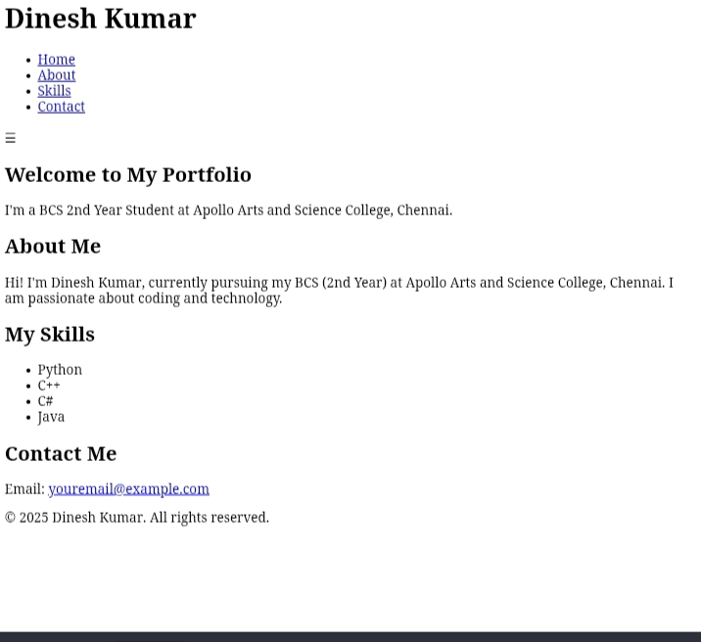
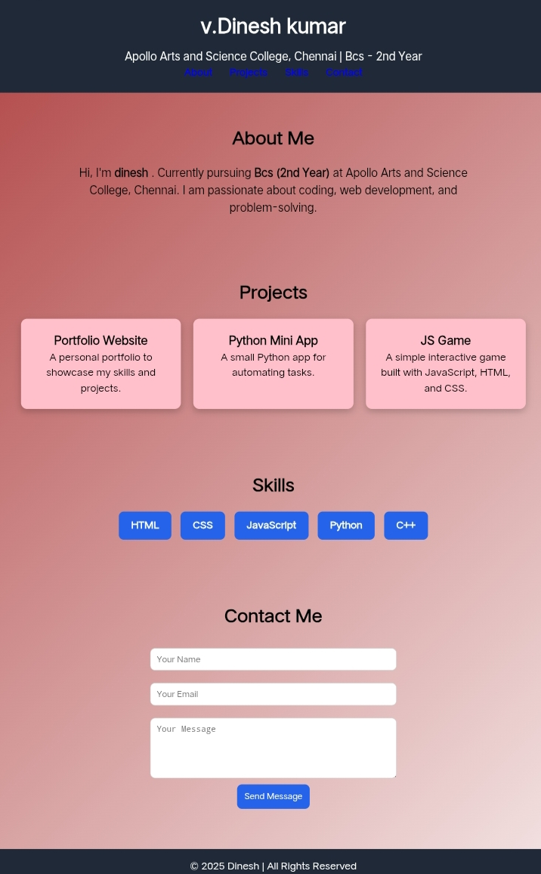
RESULTS AND screenshot
Before adding css
After adding css
3/21/2024 Annual Review
10

Slide 11
CONCLUSION
The digital portfolio provides a modern way to present my skills and projects. It serves as a dynamic resume for professors, recruiters, and clients . Built with HTML, CSS, and JavaScript, it is responsive, interactive, and easy to update.
11

Slide 12
GITHUB liNK
https://github.com/MasterDinesh2006/Digital-portfile.git

